Slide 1



KS3 Mathematics
S3 2D Representation of 3D Shapes
Notes:
The aim of this unit is to teach pupils to:
Use 2-D representations, including plans and elevations, to visualise 3-D shapes and deduce some of their properties
Material in this unit is linked to the Key Stage 3 Framework supplement of examples pp 198-201.

Slide 2


2-D representations of 3-D shapes
When we draw a 3-D shape on a 2-D surface such as a page in a book or on a board or screen, it is called a 2-D representation of a 3-D shape.
Imagine a shape made from four interlocking cubes joined in an L-shape.
On a square grid we can draw the shape as follows:
Notes:
We start by drawing the L-shape. From each vertex we draw a 45 º sloping line (point out that a line that slopes one square along for one square up slopes at an angle of 45° to the horizontal).
We then complete the drawing by joining the end-points of the sloping lines.
Notice that there are three sets of parallel lines: horizontal lines, vertical lines, and 45º sloping lines.
We can use shading to differentiate between the faces that are facing forwards, the faces that are facing to the side and the faces that are facing upwards.
The disadvantage of using a square grid to draw shapes made from cubes is that it is not possible to make the edges the same length (the 45º sloping edge is shorter).
This view is sometimes called an oblique view.

Slide 3
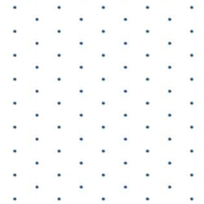
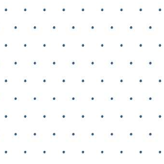
Drawing 3-D shapes on an isometric grid
The dots in an isometric grid form equilateral triangles when joined together.
When drawing an 2-D representation of a 3-D shape make sure that the grid is turned the right way round.
The dots should form clear vertical lines.

Slide 4
Drawing 3-D shapes on an isometric grid
We can use an isometric grid to draw the four cubes joined in an L-shape as follows:
Notes:
Again the diagram has three sets of parallel lines: one set is vertical, and two sets are 30º from the horizontal in opposite directions.
The advantage of drawing shapes made from cubes on isometric paper is that all the edges are the same length.

Slide 5
2-D representations of 3-D objects
There are several different ways of drawing the same shape.
Are these all of the possibilities?
Can you draw the shape in a different way that is not shown here?
How many different ways are there?
Notes:
You may wish to have a model of this shape made of interconnecting cubes in class. You can invite pupils to think logically about all of the different possible orientations there are and use the model to demonstrate these.
Challenge pupils to draw these on isometric paper.

Slide 6
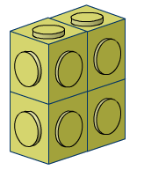
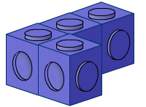
Making shapes with four cubes
How many different solids can you make with four interlocking cubes?
Make as many shapes as you can from four cubes and draw each of them on isometric paper.
Notes:
Challenge pupils to find all of the solids that can be made from four cubes. The solution is shown on the next slide. Pupils may use real cubes if they need to, but should record their results as drawings on isometric paper.
Point out that when we say ‘different’ shapes, we do not include rotations and reflections of the same shape.
Suggest to pupils that if they work systematically, they can be more certain of finding all the shapes. For example, there are only two different shapes that can be made from three cubes. Pupils could start with one of their two shapes and make shapes from four cubes by moving a single cube to different positions. They should draw each one ignoring reflections and rotations of the same shape.
These shapes are called tetracubes.

Slide 7
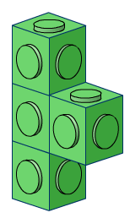
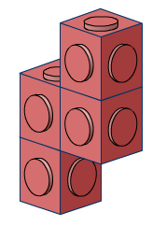
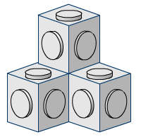
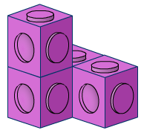
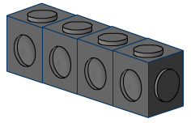
Making shapes with four cubes
You should have seven shapes altogether, as follows:
Notes:
Pupils can compare their answers with these pictures. They should be able to match shapes that they have drawn in a different orientation.

Slide 8
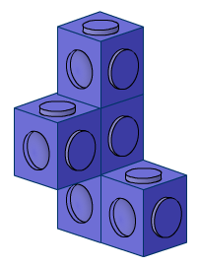
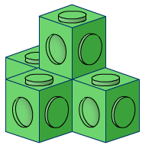
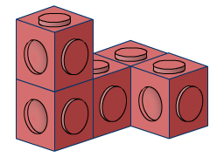
Making shapes from five cubes
Investigate the number of different solids you can make with five interlocking cubes.
Make as many as you can and draw each of them on isometric paper.
Notes:
Extend the activity to five cubes.
Pupils could start by finding all of the shapes that are made up of a single layer. There are 12 of these, called pentominos.
Pupils can then move on to using more layers to make pentacubes. There are 11 shapes made from more than one layer, not including rotations and reflections.
If reflections are allowed, there are 29 possible shapes altogether (not including reflections there are 23).

Slide 9
Opposite faces
Here are three views of the same cube.
Each face is painted a different colour.
What colours are opposite each other?
Notes:
This problem shows different isometric views of the same cube.
Establish that the yellow and blue faces are opposite each other, as are the green and the pink faces, and the orange and the purple faces.
Ask pupils to justify their reasoning.

